Slide 1
CSC 110 Java Programming
Software Development Process

Slide 2
Objectives
You will be able to:
Describe Software Development Process
Analyze problem solving Techniques
Write Algorithms
Define Computer Science and Software Engineering

Slide 3
Software Development Process
Computer program are used to solve problems. To do this a programmer must perform the following two major activities.
1. Define and design an approach for solving problems
2. Convert the design from human definition to a representation that a computer can understand
Developing Software is not just writing code. There are several phases or steps that are taken to create a successful and robust software.

Slide 4
Software Development Process
The steps that are involved are
1. Analysis :
Define what the program is supposed to do. During this process, all the input, output, restrictions and assumptions are clarified. (This is the part that I will provide to you as a programming assignment )
2. Design:
Develop a design or method to solve the problem. These designs are called “Algorithms”. An algorithm is a set of steps to perform a task or solve a problem. All steps must be taken in a logical order. There are several tools that can be used to write algorithms. In this class we will be using is called pseudocode.

Slide 5
Software Development Process
3. Coding:
After the design is created than is the time to write the design in a programming language. In this class we will be converting our design (algorithm) into Java Programming language. The code is then converted into a form that it can be executed on the computer.
4. Testing:
The software must be tested to make sure that it is doing what it is supposed to do. In this phase a program is run using test data as input. The result/output of the program is checked against the requirements.
If the output does not match the requirements then correct any errors found by going back to the Design phase, followed by the Coding phase and then Testing. This process of design, coding and testing continues until output match the requirements. A misspelled programming language word

Slide 6
Problem Solving Techniques
Break Down the Problem into its Component Parts
Input: Identify and Isolate the input
Process: Separate the algorithm processing
Output: Identify and Isolate the output
Sometime it is called as IPO
Algorithm Design Tools:
Pseudocode: It consists of English language like sentences that is written in order to breaks the problem into steps.

Slide 7
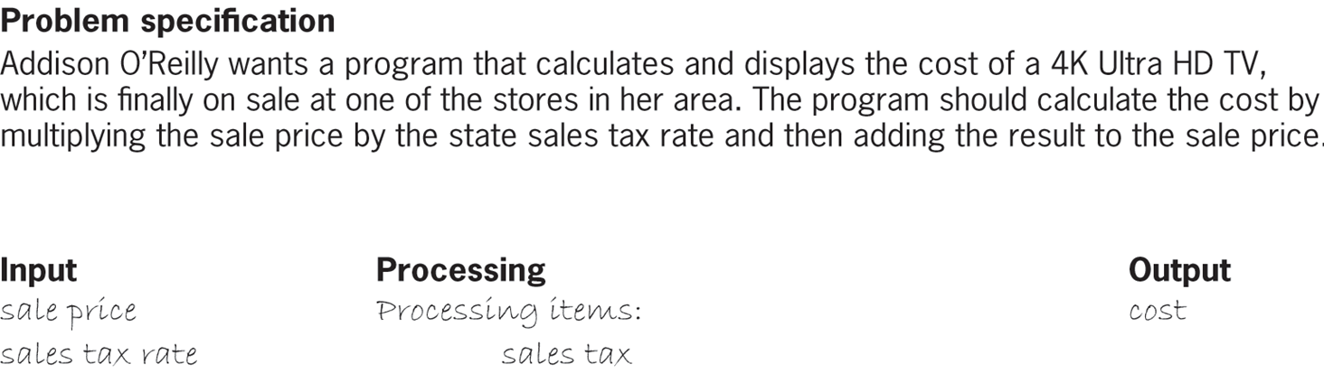
Pseudo code

Slide 8

Pseudo Code

Slide 9
Software Engineering V Computer Science
Computer Science deals with the notion of developing ideas and processes that can be used to solve computer –related problems
Software Engineering involves applying the principles of computer science to solve business and engineering related problems.
© 2019 Cengage. May not be copied, scanned, or duplicated, in whole or in part, except for use as permitted in a license distributed with a certain product or service or otherwise on a password-protected website for classroom use.

